Slide 1
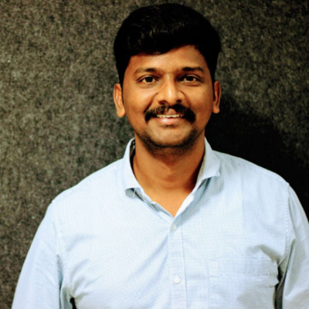
From Data to Decisions: Leading in the Age of AI
By Gunarathinam M
Sr. Database Architect @ ADP

Slide 2
Introduction
Market Map of Data Ecosystem(MAD Landscape)
Why this topic matters?
The Shift: BI -> AI
What Data Leadership Means Today?
Data Leadership Pillars
Leadership Framework
Domain Centric
Maturity Model
Small & Scale
Closing Quote

Slide 3
Most organizations don’t have a data problem. They have a decision problem.
Organizations are rich in data
Many have dashboards, reports, even AI models
Yet… decisions are still slow, inconsistent, or wrong
This is not about tools – its leadership.

Slide 4
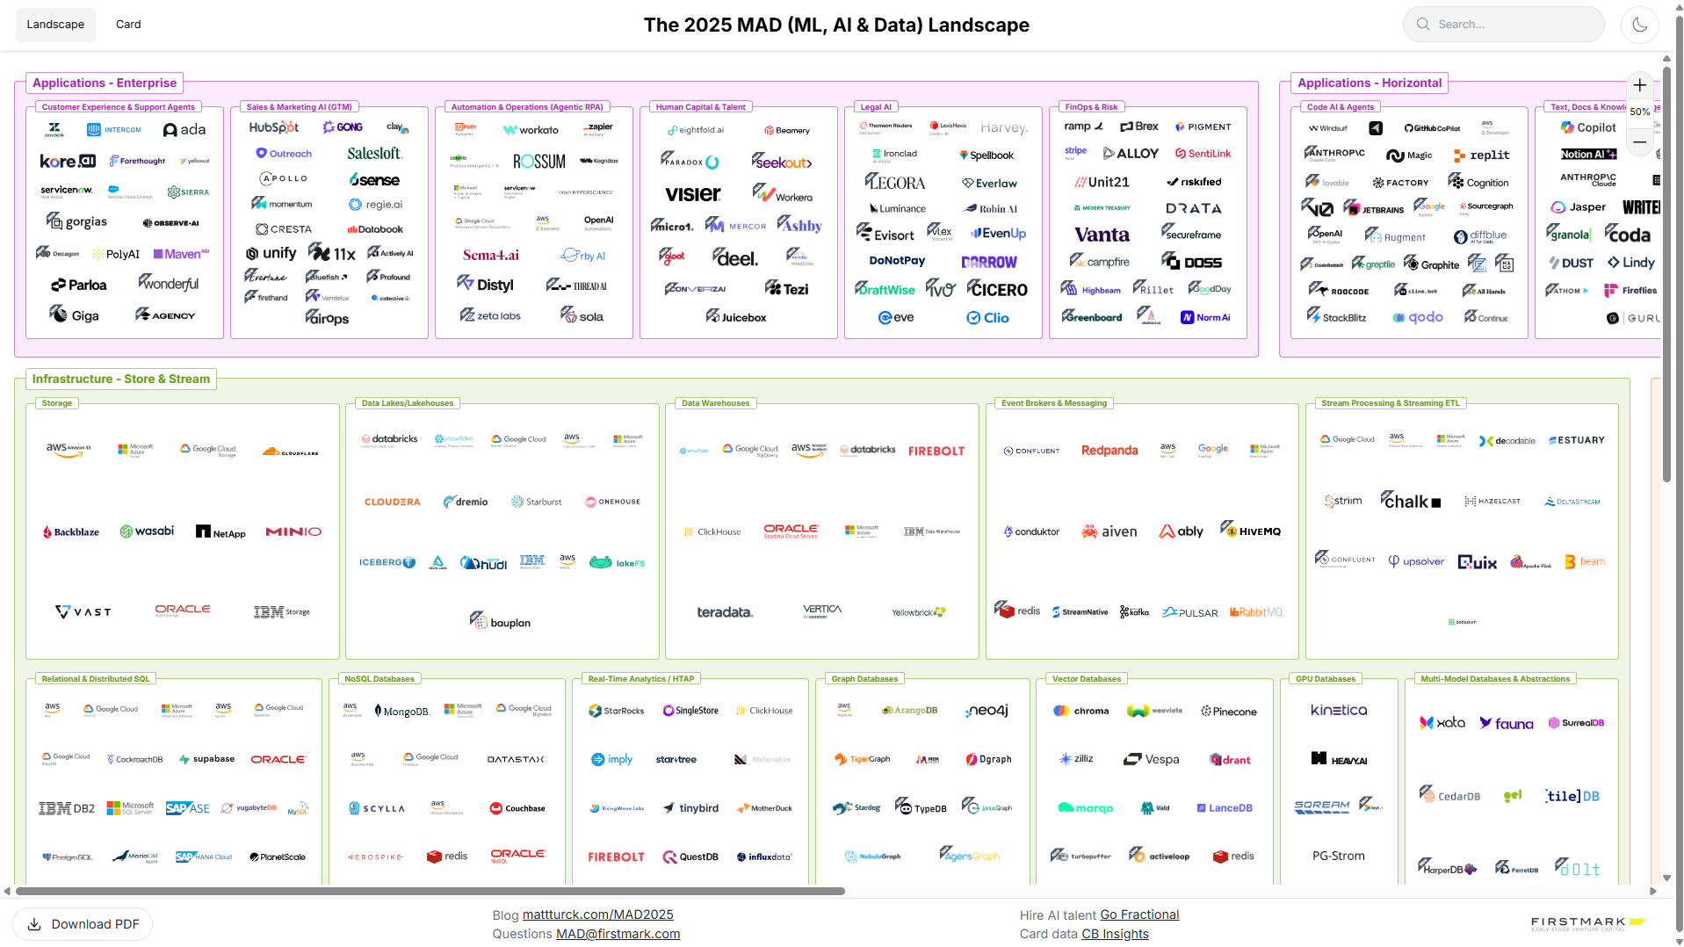
Market Map of Data Ecosystem
Source: https://mad.firstmark.com/

Slide 5
Why this topic Matters?
Business wants faster, smarter decisions
Leaders expect predictive & automated insights
Data teams are no longer support — they are strategic drivers
Leadership must evolve faster than technology.

Slide 6
The Shift: BI -> AI
Traditional BI | AI-Driven World
What Happened? | What will happen?
Dashboards | Predictions
Manual Decisions | Assisted/Automated Decisions
Data Teams = Support | Data teams = Strategic
Shifts from Insights -> Impact

Slide 7
What Data Leadership Means Today?
Connect business goals ↔ data strategy
Drive decision-making culture
Ensure data trust & governance
Balance AI + human judgment
From reporting leader → decision enabler

Slide 8
Data Leadership Pillars:
1-Data as Product
Clear ownership (data owners, not just engineers)
Defined quality standards (accuracy, freshness)
SLAs for availability
Designed for consumption (not storage)
2-Decision-Driven Analytics
What decision are we improving?
Who will use this insight?
What action will change?
3-AI + Human Collaboration
AI for scale and speed
Humans for context and judgment
Define:
Where AI recommends
Where humans decide
4-Trust & Governance
Data quality issues kill credibility
AI bias & explainability concerns
Regulatory & compliance needs
If data is not usable, it has no value
No decision → No value
Best outcomes come from collaboration
Trust is the foundation of data leadership

Slide 9
Leadership Framework: Domain Centric
Technology-Centric | Domain-Centric
Build platforms | Solve business problems
Focus on tools | Focus on outcomes
Data availability drives projects | Business priorities drive projects
Success = technical completion | Success = business impact
IT-led | Business-aligned
Reports & dashboards | Decisions & actions
Source: https://fwpr.com/navigating-the-analytics-maturity-model/

Slide 10
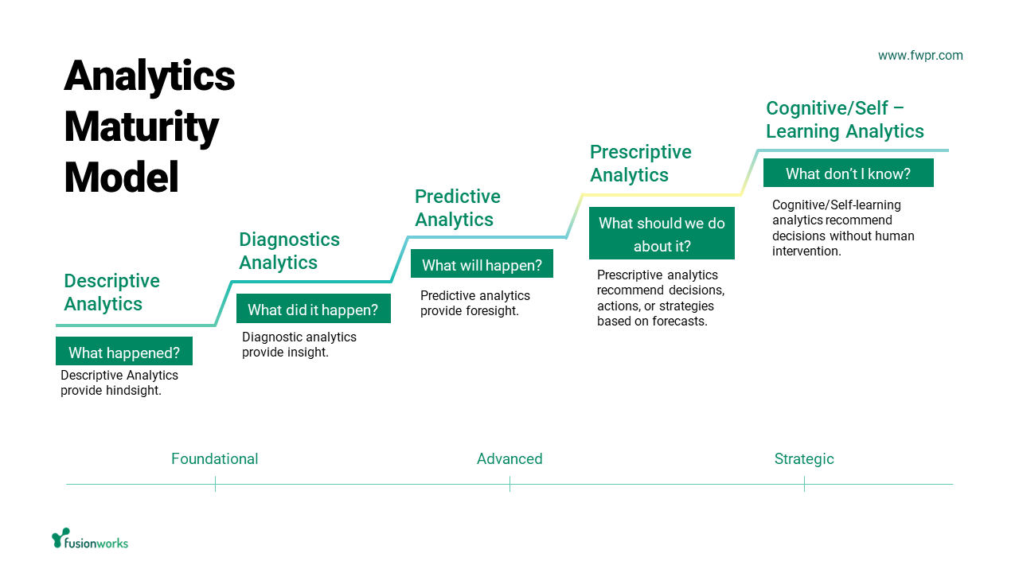
Leadership Framework: Maturity Model
Source: https://fwpr.com/navigating-the-analytics-maturity-model/

Slide 11
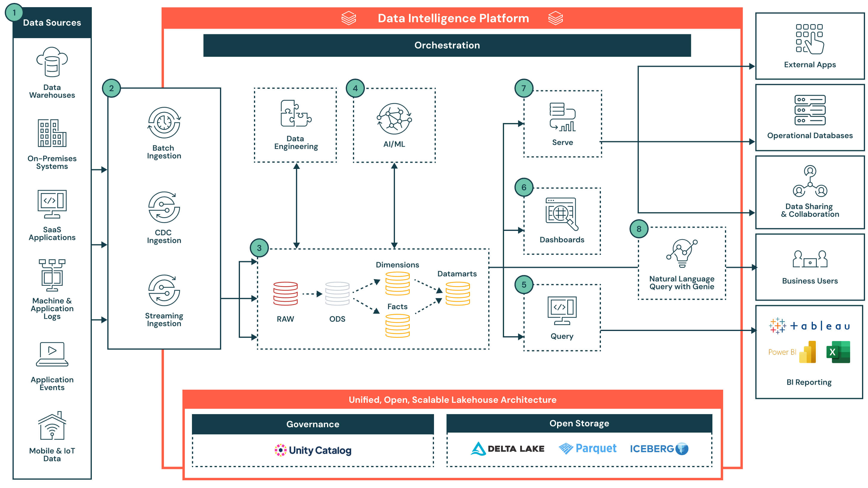
Leadership Framework: Architecture – Big Picture
https://www.databricks.com/resources/architectures/intelligent-data-warehousing-on-databricks

Slide 12
Leadership Framework: Start small, scale with Impact
Identify a High-Impact Business Problem
Painful | Visible | Measurable | Frequently occurring
Build a Small, Focused MVP
One dashboard | One AI use case | One workflow automation
Deliver Quick Wins
6–12 week outcomes | Visible business value | Executive-friendly metrics
Build Trust & Adoption
Train users | Simplify outputs | Make insights actionable
Scale What Works
Expand to departments |Reuse data foundations |Standardize governance | Introduce advanced AI

Slide 13
"Impatience with actions, patience with results.“
– By Eric Jorgenson

Slide 14
Thank You

Slide 15
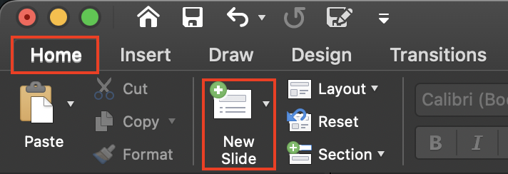
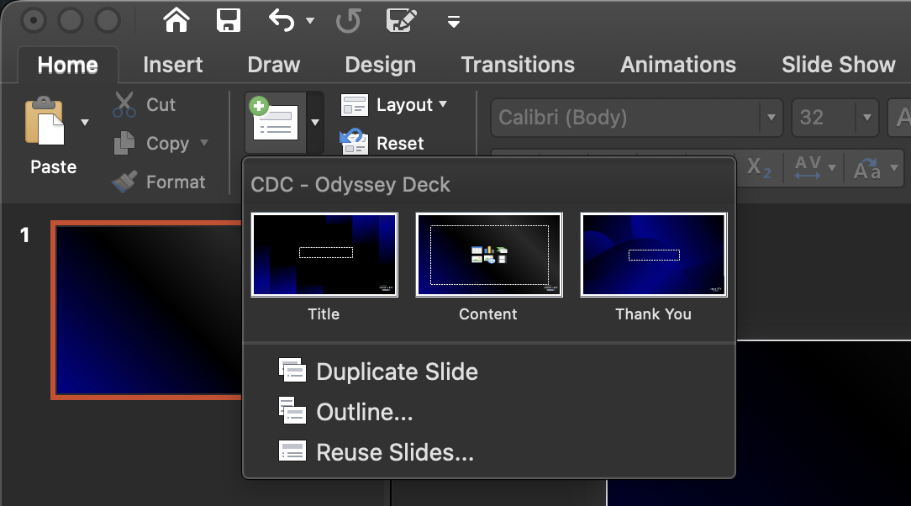
Add New Slides Instructions – Delete This
To add a new slide, go to “New Slide” and choose the appropriate layout. Except for the Title and Outro/Thank You slides, please use the “Content” slide layout.
Use white font color throughout the presentation and maintain a minimum font size of 24 pt with 1.5 as line spacing for better visibility.
Avoid overcrowding a single slide with too many points, as it can be difficult for the audience to read from a distance. Keep content concise and visually balanced.

Slide 16
General Instructions – Delete This
Feel free to include your photo and LinkedIn Profile QR in the presentation, and encourage the audience to connect with you.
Start your presentation with a strong hook to capture attention and keep the audience engaged throughout the session.
Please be mindful of the allotted time and ensure your presentation is completed within the given duration.
Watch out for the “Time Out” card so you don’t have to keep checking your watch.
Most importantly, enjoy the stage and have a great session. Happy Talking!

